Slide 1

Application of Number Theory in Public-Key Cryptography
Yang Zheng
Instructor：Qiao Yan

Slide 2
Catalog
Background
Public-Key Cryptosystems
RSA
ElGamal
Conclusion

Slide 3
part 1
Background

Slide 4









Background
Symmetric Cryptography
Key
Key
Diffie-Hellman:
DH key distribution
Message
Encryption
Decryption
Output Message
$$Example:$$
$$Drawbacks:$$
Key Management
Unsafety
$$C=\left(M+3\right)\%127$$
$$I love you.$$
$$L\#oryh\#|rx1$$
Key Compromise
Sending Process
$$M=\left(C−3+127\right)\%127$$

Slide 5
part 2
Public-Key Cryptosystems

Slide 6









Public-Key Cryptosystems
Brief process
Diffie-Hellman
Bob’ public key
Bob’ private key
Alice
Bob
Bob
Bob’ public key
Bob’ private key
$$E({Pub}_{B},M)$$
$$D({Pri}_{B},M)$$
Message
Ciphertext
Message
Alice
Bob

Slide 7
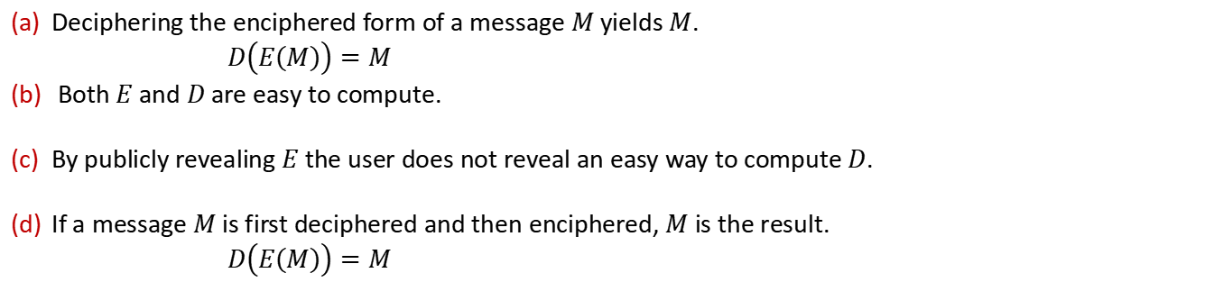
Public-Key Cryptosystems
Properties
Deciphering the enciphered form of a message $M$ yields $M$.
$D\left(E\left(M\right)\right)=M$
Both $E$ and $D$ are easy to compute.
By publicly revealing $E$ the user does not reveal an easy way to compute $D$.
If a message $M$ is first deciphered and then enciphered, $M$ is the result.
$D\left(E\left(M\right)\right)=M$

Slide 8
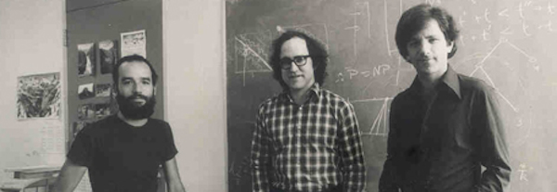
Public-Key Cryptosystems
The First Public Key Encryption Algorithm
From left to right：Adi Shamir, Ron Rivest, Leonard Adleman

Slide 9
part 3
RSA

Slide 10
Catalog
Methods
Proof
Details
Security of the Method
Signature

Slide 11
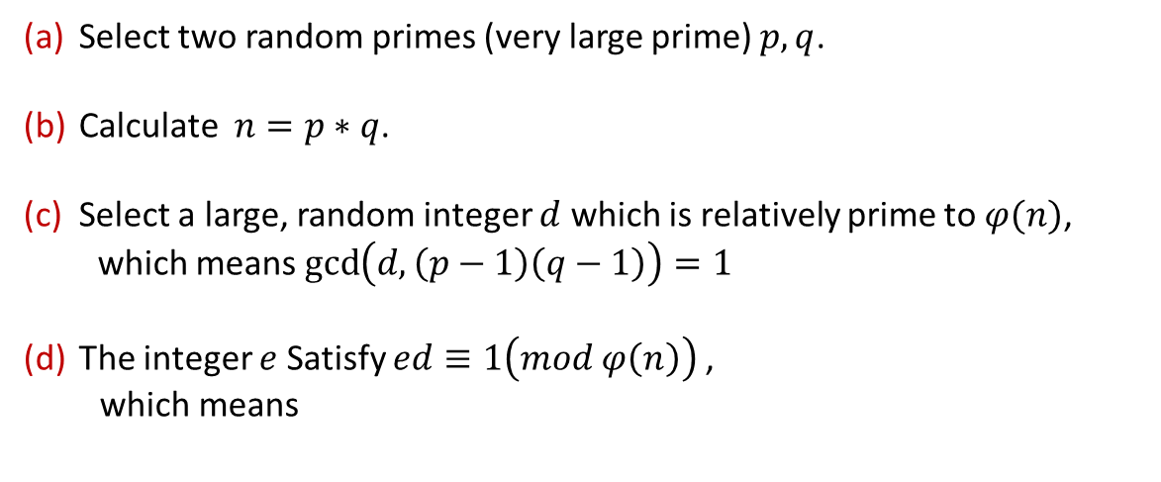



RSA--Methods
Key Generation
$φ\left(n\right)$
$$−Euler function$$
$$\sum_{i=1}^{n−1}{[\gcd\left(i,n\right)==1]}$$
$$\left(e,n\right):public key \left(d,n\right):private key$$
Select two random primes (very large prime) $p,q$.
Calculate $n=p∗q$.
Select a large, random integer $d$ which is relatively prime to $φ(n)$,
which means $\gcd\left(d, \left(p−1\right)\left(q−1\right)\right)=1$
The integer $e$ Satisfy $ed≡1\left(mod φ\left(n\right)\right)$,
which means
$properties:$
$if\gcd\left(a,b\right)=1,$
$$φ\left(ab\right)=φ\left(a\right)φ\left(b\right)$$
$if n is a prime,$
$$φ\left(n\right)=n−1$$
$$ed=kφ\left(n\right)+1$$

Slide 12


RSA--Methods
Encryption and Decryption Methods
$$\left(e_{b},n\right):public key$$
$$\left(d_{b},n\right):private key$$
$$M:message(1≤M≤n−1)$$
Alice
$$C=E\left(M\right)=M^{e_{b}} mod n$$
$$C:ciphertext$$
$$M=D\left(C\right)=C^{d_{b}} mod n$$

Slide 13



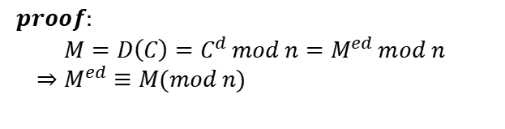

RSA--Proof
Underlying Mathematics
$$1≤M≤n−1$$
$$n=p∗q$$
$$φ\left(n\right)=φ\left(p\right)∗φ(q)$$
$$ed≡1\left(mod φ\left(n\right)\right)$$
$$C=E\left(M\right)=M^{e} mod n$$
$$M=D\left(C\right)=C^{d} mod n$$
$proof:$
$M=D\left(C\right)=C^{d} mod n=M^{ed} mod n$
$⇒M^{ed}≡M(mod n)$
$$ed≡1\left(mod φ\left(n\right)\right)$$
$M^{kφ\left(n\right)+1}≡M(mod n)$
$$ed=kφ\left(n\right)+1$$

Slide 14








RSA--Proof
Underlying Mathematics
$$1≤M≤n−1$$
$$n=p∗q$$
$$φ\left(n\right)=φ\left(p\right)∗φ(q)$$
$$ed≡1\left(mod φ\left(n\right)\right)$$
$M^{kφ\left(n\right)+1}≡M(mod n)$
$case 1. \gcd\left(M,n\right)=1$
$case 2. \gcd\left(M,n\right)≠1$
$$Theorem1. M^{φ\left(n\right)}≡1\left(mod n\right)$$
$$M=tp or M=tq$$
$${\left(M^{φ\left(n\right)}\right)}^{k}M≡M\left(mod n\right)$$
$$we set M=tq$$
$$\gcd\left(M, p\right)=1$$
$$Theorem2. M^{p−1}≡1\left(mod p\right)$$
$${\left(M^{p−1}\right)}^{k(q−1)}M≡M\left(mod p\right)⇒M^{kφ\left(n\right)+1}≡M\left(mod p\right)$$
$${(tq)}^{kφ\left(n\right)+1}=hp+M=hp+tq=yqp+tq=yn+tq$$
${(tq)}^{kφ\left(n\right)+1}$ $≡tq\left(mod n\right)⇒M^{kφ\left(n\right)+1}=M(mod n)$

Slide 15
RSA—Methods(review)
Key Generation
$φ\left(n\right)$
$$−Euler function$$
$$\sum_{i=1}^{n−1}{[\gcd\left(i,n\right)==1]}$$
$$\left(e,n\right):public key \left(d,n\right):private key$$
Select two random primes (very large prime) $p,q$.
Calculate $n=p∗q$.
Select a large, random integer $d$ which is relatively prime to $φ(n)$,
which means $\gcd\left(d, \left(p−1\right)\left(q−1\right)\right)=1$
The integer $e$ Satisfy $ed≡1\left(mod φ\left(n\right)\right)$,
which means
$properties:$
$if\gcd\left(a,b\right)=1,$
$$φ\left(ab\right)=φ\left(a\right)φ\left(b\right)$$
$if n is a prime,$
$$φ\left(n\right)=n−1$$
$$ed=kφ\left(n\right)+1$$

Slide 16






RSA--Details
How to Find Large Prime Numbers
$$prime number theorem: \lim_{n→∞}{π\left(n\right)}=\frac{n}{ln(n)}$$
$$n=p ∗q$$
$$possibility: \frac{1}{ln(n)}$$
$$example:n=2^{2048}⇒ \frac{1}{ln(n)}=\frac{1}{ln(2^{2048})}≈1420$$
$$prime test$$
$$Miller−Rabin algorithm$$

Slide 17
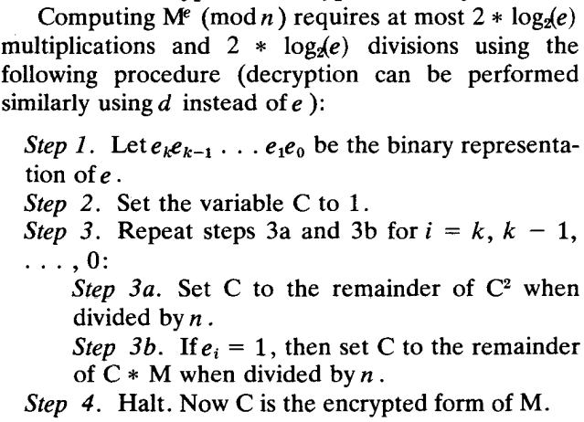


RSA--Details
Encrypt and Decrypt Efficiently
$$\left(e,n\right):public key$$
$$C=E\left(M\right)=M^{e} mod n$$
$$M=D\left(C\right)=C^{d} mod n$$
$$\left(d,n\right):private key$$

Slide 18





RSA--Details
$$φ\left(n\right)=φ\left(p\right)∗φ\left(q\right)$$
$=\left(p−1\right)(q−1)$
$\gcd\left(d, \left(p−1\right)\left(q−1\right)\right)=1$
$$ed≡1\left(mod φ\left(n\right)\right)$$
How to Choose $d$
$gcd\left(d, φ\left(n\right)\right)=1$⬄ $gcd\left(d, \left(p−1\right)\left(q−1\right)\right)=1$
$$any prime number greater than max(q,p)$$
How to Compute $e$ from $d$ and $φ(n)$
$$ed≡1\left(mod φ\left(n\right)\right)$$
$$ed+\left(−y\right)φ\left(n\right)=1=\gcd\left(e,φ\left(n\right)\right)$$
$$extended Euclid^{′}s algorithm$$

Slide 19
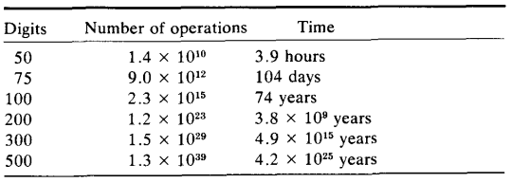

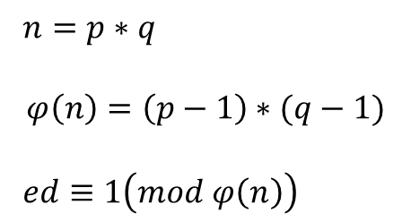

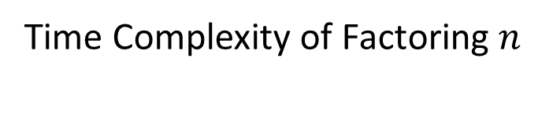

RSA--Security of the Method
$$\left(e,n\right):public key \left(d,n\right):private key$$
Factoring $n$
$$M:message(1≤M≤n−1) C:ciphertext$$
$n=p∗q$
$$φ\left(n\right)=\left(p−1\right)∗(q−1)$$
$ed≡1\left(mod φ\left(n\right)\right)$
$$C=E\left(M\right)=M^{e} mod n$$
$d$
$$M=D\left(C\right)=C^{d} mod n$$
Time Complexity of Factoring $n$

Slide 20



RSA--Signature
Digital Signature
$$\left(e_{a},n\right):public key$$
$$\left(d_{a},n\right):private key$$
$$M:message(1≤M≤n−1)$$
Alice
$$C:ciphertext$$
$$S=D\left(M\right)=M^{d_{a}} mod n$$
$$S:signature$$
$$M=D\left(S\right)=S^{e_{a}} mod n$$

Slide 21
part 4
ElGamal

Slide 22
Catalog
Review of Diffie-Hellman Key Distribution
Methods
Signature

Slide 23


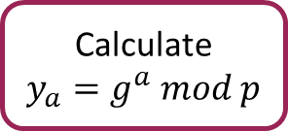


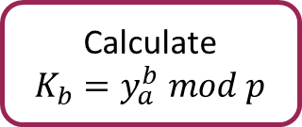
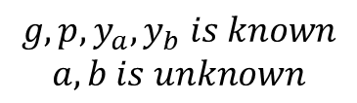
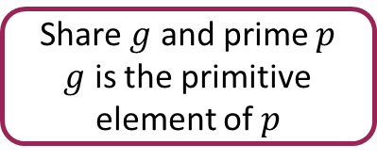


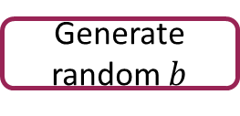





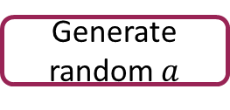


ElGamal--Review of Diffie-Hellman key distribution
$$Proof:$$
$y_{b}^{a} mod p={\left(g^{b}\right)}^{a} mod p=g^{ab} mod p$
Alice
Bob
$y_{a}^{b} mod p={\left(g^{a}\right)}^{b} mod p=g^{ab} mod p$
Share $g$ and prime $p$
$g$ is the primitive element of $p$
Share $g$ and prime $p$
$g$ is the primitive element of $p$
$$Security:$$
$$g, p, y_{a}, y_{b} is known$$
$$a,b is unknown$$
$$calculate K_{a} or K_{b}$$
Generate random $a$
Generate random $b$
$$y_{a}$$
$$K_{a}=y_{b}^{a} mod p$$
Calculate
$y_{a}=g^{a} mod p$
Calculate
$y_{b}=g^{b} mod p$
$$y_{b}$$
$K_{b}=y_{a}^{b} mod p$
$$calculate a, b use y_{a}=g^{a} mod p$$
Calculate
$$K_{a}=y_{b}^{a} mod p$$
Calculate
$K_{b}=y_{a}^{b} mod p$
$$discrete logarithms problem$$

Slide 24
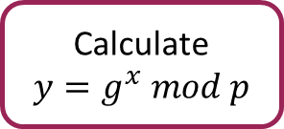



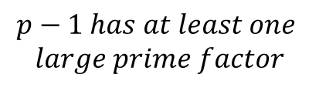

ElGamal--Methods
Key Generation
$$\left(g,p,y \right):public key$$
$$p−1 has at least one$$
$$large prime factor$$
$$x:private key$$
Share $g$ and prime $p$
$g$ is the primitive element of $p$
Generate random $x$
Calculate
$y=g^{x} mod p$

Slide 25





ElGamal--Methods
Encryption and Decryption Methods
$$\left(g,p,y_{b} \right):public key$$
$$x_{b}:private key$$
$$M:message(0≤M≤p−1)$$
Alice
$$K=y_{b}^{k} mod p$$
$$C_{1}=g^{k} mod p$$
$$C_{2}=K∗M mod p$$
$y_{b}=g^{x_{b}} mod p$
$$C_{1}C_{2}:ciphertext$$
$$K=C_{1}^{x_{b}} mod p$$
$$M=C_{2}∗K^{−1} mod p$$
Bob

Slide 26



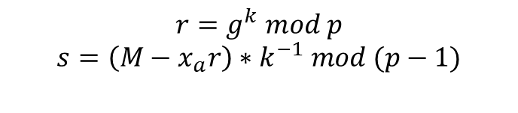
ElGamal--Signature
Digital Signature
$$\left(g,p,y_{a} \right):public key$$
$$x_{a}:private key$$
$$M:message(0≤M≤p−1)$$
Alice
$y_{a}=g^{x_{a}} mod p$
$$r=g^{k} mod p$$
$$s=\left(M−x_{a}r\right)∗k^{−1} mod (p−1)$$
$$(C_{1},C_{2}):ciphertext$$
$$(r,s):signature$$
$$M$$
Bob
$$(r,s):signature$$
$$test if y_{a}^{r}r^{s}≡g^{M} mod p$$

Slide 27
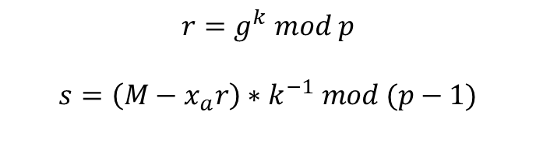


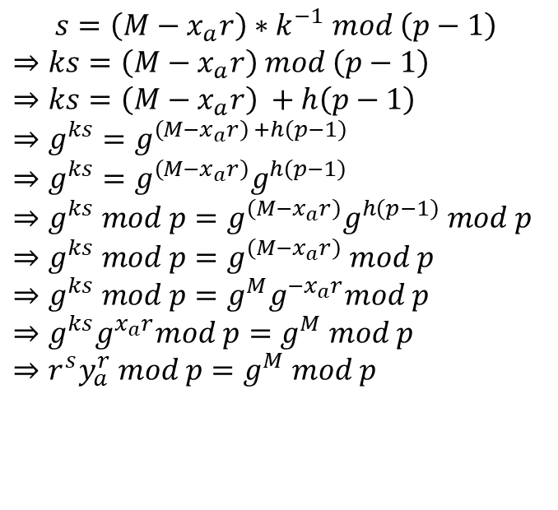
ElGamal--Signature
Proof
$$\left(g,p,y_{a} \right):public key$$
$$test if y_{a}^{r}r^{s}≡g^{M} mod p$$
$$x_{a}:private key$$
$s=\left(M−x_{a}r\right)∗k^{−1} mod \left(p−1\right)$
$⇒ks=\left(M−x_{a}r\right) mod \left(p−1\right)$
$⇒ks=\left(M−x_{a}r\right) +h\left(p−1\right)$
$⇒g^{ks}=g^{\left(M−x_{a}r\right) +h\left(p−1\right)}$
$⇒g^{ks}=g^{\left(M−x_{a}r\right)}g^{h\left(p−1\right)}$
$⇒g^{ks} mod p=g^{\left(M−x_{a}r\right)}g^{h\left(p−1\right)} mod p$
$⇒g^{ks} mod p=g^{\left(M−x_{a}r\right)} mod p$
$⇒g^{ks} mod p=g^{M}g^{−x_{a}r}mod p$
$⇒g^{ks}g^{x_{a}r}mod p=g^{M} mod p$
$⇒r^{s}y_{a}^{r} mod p=g^{M} mod p$
$$(r,s):signature$$
$y_{a}=g^{x_{a}} mod p$
$$r=g^{k} mod p$$
$$s=\left(M−x_{a}r\right)∗k^{−1} mod (p−1)$$
$$g^{p−1}≡1(mod p)$$

Slide 28
part 5
Conclusion

Slide 29



Conclusion
Advantage: High safety（Large number decomposition）
Drawbacks: Long encryption time
Application: Hybrid encryption

Slide 30
References
[1] https://blog.csdn.net/jiang_xinxing/article/details/89360638
[2] R. Merkle, “Secure communication over an insecure channel,” Communications of the ACM.
[3] Diffie W. and Hellman M., New directions in cryptography. IEEE Trans. Inform. Theory IT-22, 1976.
[4] Michael Calderbank, “The RSA Cryptosystem: History, Algorithm, Primes,” 2007.
[5] R.L.Rivest, A.Shamir, L.Adleman, “A method for obtaining digital signatures and public-key cryptosystems,” Communications of the ACM, 1978.
[6] ElGamal T. A public key cryptosystem and a signature scheme based on discrete logarithms[J]. IEEE transactions on information theory, 1985, 31(4): 469-472.

Slide 31
THANKS
2022.5.25

